Slide 1
ENDSOCOPIC INTERNAL DRAINAGE WITH DOUBLE PIG TAIL STENTS: RIGHT TIMING FOR USING THEM
P. Melatti
Ospedale buccheri la ferla - palermo

Slide 2
Endoscopic internal drainage (EID)
Endoscopy is now considered the first-line approach for the management of post surgical leaks. Less
invasive approaches are preferred, when possible, to reduce associated morbidity.
Closure techniques:
Suturing devices
Over-the scope and through-the scope clips
Draining techniques:
Endoscopic internal drainage
Endoscopic septotomy
Covering techniques:
Self-expandable metal stents
Cardiac septal defect occluder
de Oliveira VL, Choosing the best endoscopic approach for post-bariatric surgical leaks and fistulas: Basic principles and recommendations. World J Gastroenterol. 2023 Feb 21

Slide 3
Endoscopic internal drainage (EID)
Good results have been reported using a Double-Pigtail Stent (DPS) for internal drainage of the gastric leak, allowing a shorter hospital stay and facilitating perioperative management.
The principle for internal drainage is based on the concept that when the pressure within the gastric
lumen is lower than that of the perigastric collection, flow will be directed into the GI tract.
The largest study evaluating EID with DPS for the treatment of complications after BMS included 617
patients, with a clinical success rate of 89.5% for leaks and 78.5%, for fistulas.
de Oliveira VL, Choosing the best endoscopic approach for post-bariatric surgical leaks and fistulas: Basic principles and recommendations. World J Gastroenterol. 2023 Feb 21

Slide 4
Clinical case
A 39-year-old female with a body mass index (BMI) 35 kg/m2 underwent a laparoscopic sleeve gastrectomy (LSG). On the second day post operatively, she presented to the ER with abdominal pain, leukocytosis and increased C-reactive protein (CRP).
The CT showed a voluminous peri-gastric collection (4x3x5 cm). The esophagogastroduodenoscopy (EGD) revealed a leak at the proximal third of the stomach, near the gastroesophageal junction.
Two double pigtail stents (Boston Scientific, Marlborough, MA, USA) were inserted over the guidewire, with one end of the stent placed within the collection and the other end into the stomach lumen, to allow internal drainage of the collection. A naso-jejeunal tube was placed to allow oral feeding.

Slide 5
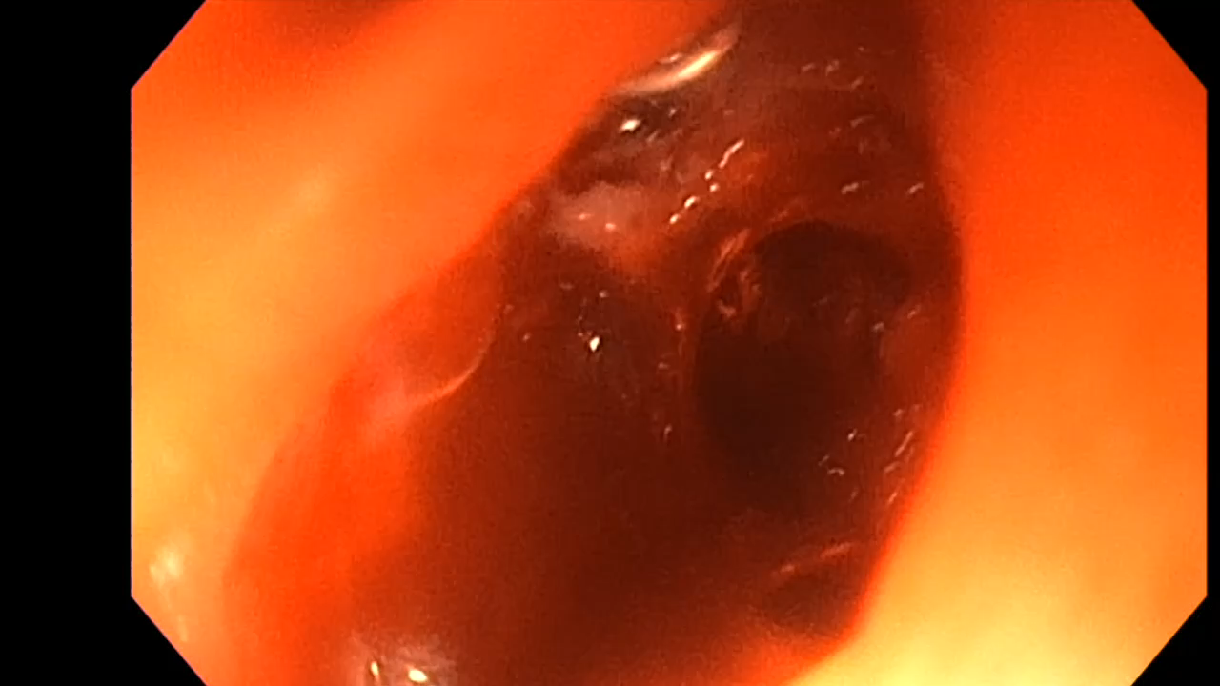
Clinical case

Slide 6
Clincal case
After one week, the CT showed an expansion of the collection, despite of the endoscopic internal drainage (EDI). She underwent emergency surgery, with placement of three external drainages and splenectomy. The two doble pigtail stents were removed. During EGD, a fully covered metal stent 18x119 mm (Agile Esophageal18x119mm Boston ScientificMarlborough, MA, USA) was released, with the proximal end upon the leak, and the distal end beyond the pylorus. Using Apollo OverStitchTM, the proximal edge of the stent was sutured into the esophageal mucosa to prevent migration.
After three weeks, the control CT scan showed a reduction of the collection volume. During EGD, the fully covered metal stent was removed, and the presence of the leak was confirmed. The fluoroscopy view showed persistance of the perigastric collection. Two new double pigtail stent were placed to allow internal drainage of the collection.
After one month, the CT showed a resolution of the perigastric collection. The two double pigtails stent were removed and the EGD showed closure of the gastric leak.

Slide 7
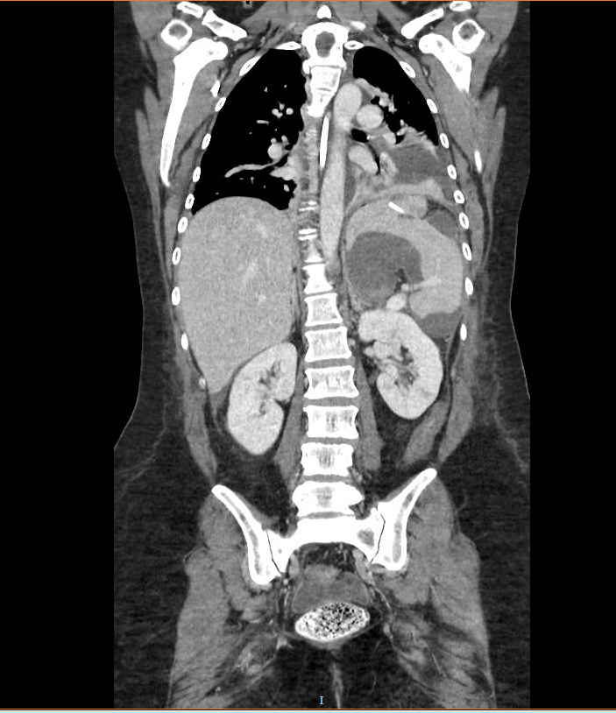
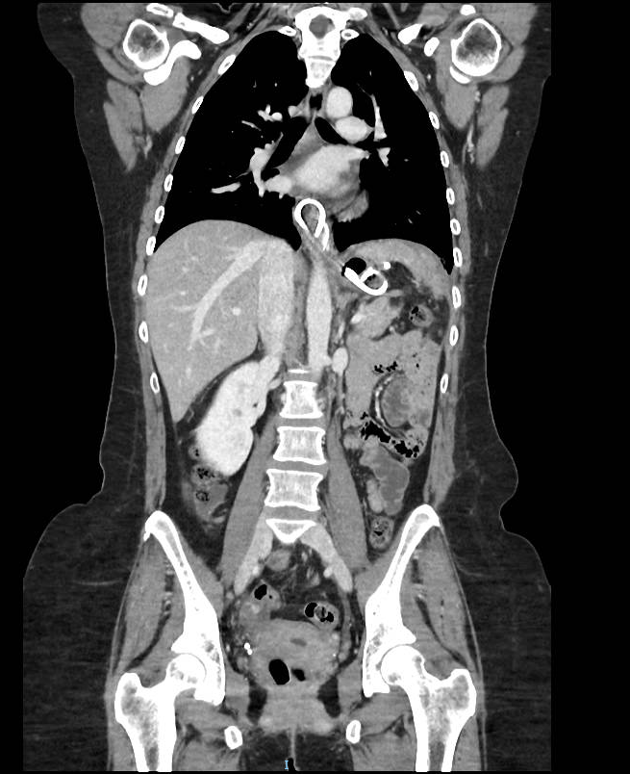

Slide 8
Endoscopic internal drainage (EID)
This is not a new concept in the management of intraabdominal collections, since it has been used with good succes rates in the pancreatic pseudocyst drainage and in the walled-off pancreatic necrosis (WOPN).
Arvanitakis Marianna et al. Endoscopic management of acute necrotizing pancreatitis, Endoscopy 2018; 50: 524–546

Slide 9
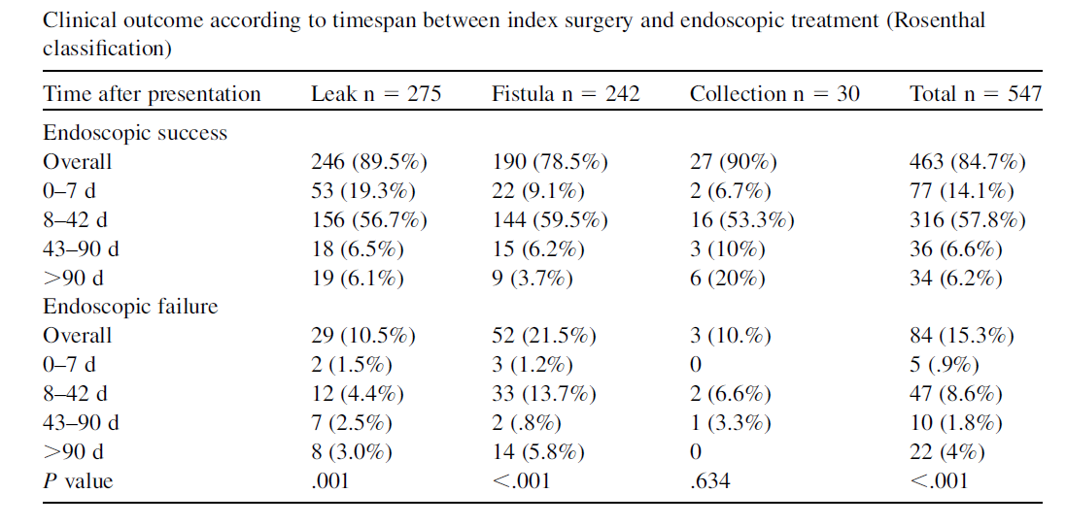
Endoscopic internal drainage (EID)
The technique allows internal drainage of the collection, using an already present wall defect.
The time between bariatric surgery and drainage varies between the study. Bouchard et al reported a time interval of 47 days. Donatelli et al described a time interval of 25.6 days in one study, and of 60.5 days in another one.
 | Median time (d) | Success rate (%)
Bouchard et al, 2016 | 47 d | 78.8%
Donatelli et al, 2014 | 25.6 d | 95.2%
Donatelli et al, 2016 | 60.5 | 78.2%
Christophorou et al, 2015 | >30 d | 73.6%
Giuliani A, et al, Gastric Leak After Laparoscopic Sleeve Gastrectomy: Management with Endoscopic Double Pigtail Drainage. A Systematic Review, Surgery for Obesity and Related Diseases (2019),

Slide 10
Take home messages
The management of early sleeve gastrectomy leaks remain challenging, and there is still no consensus on the optimal approach.
EID is a valid approach, with low rate of complications and good tolerance by patients.
Even if EID using plastic double pig tail stents is the best option recommendend in acute and small leaks, their use when the collection is not walled-off yet could not be the most effective treatment.

Slide 11
Grazie

